Slide 1
RUBISTROOPIE GAME
Co-Created by Kimberley Tse & Tiffany Fai
A simple terminal application developed in Ruby

Slide 2




WHY THIS TERMINAL APPLICATION
Time
Simplicity
Interesting
Applicable
Notes:
We were realistic with time and conscious about having a completed product
Simple concept which we can build on depending on progress
When Tiffany first explained the idea while we were brainstorming, this one caught my attention when we were brainstorming and sounded fun and interesting
It’s great that we could incorporate this app with our recent meditating practice

Slide 3

HOW THE GAME WORKS
THE STROOP EFFECT
BLACK
BLUE
ROUND 1 - congruent colors
ROUND 2 - conflicting colors
Notes:
In its basic form, Stroop effect is when you take longer trying to name the text color because the word is different.
Like in this card (example on the screen) – the text color here is BLUE when the word is actually RED
Whereas in this next example, when the text color is the same as the meaning of the word people usually perform much quicker
In our app we have 2 rounds (first one with same colored words, and second with conflicting colored words), each with a set of 15 words.
This tests looks at your reaction time to assess your brains processing time with there is, or isn’t any distractions

Slide 4
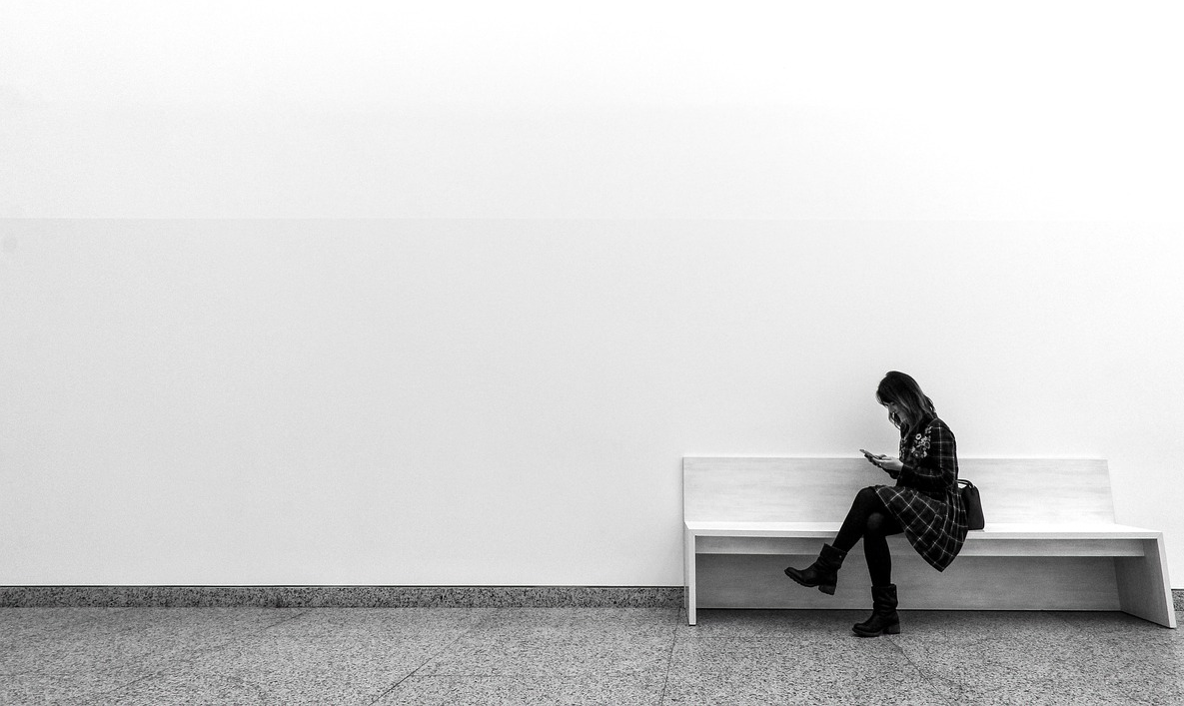
UX DESIGN & CHALLENGES
Considerate data collection
Thoughtful layout of the game
Notes:
We were user sensitive in the data collection process
For each data point we considered what is most appropriate
E.g. gender we did some research and use a gender inclusive list
E.g. age we allow valid entry to be from 3-120yo
We wanted to keep the game simple with a user friendly interface
We have a nice banner at the start and a thoughtful message at the end
We use child-friendly, with no specific gender or cultural bias and positive language throughout the app
We paid special attention to the layout of the game
When to use the keyboard and well timed breaks between sections
We use fixed white background for each color card to avoid any user discrepancies/ performance issues if their terminal background is a different color

Slide 5
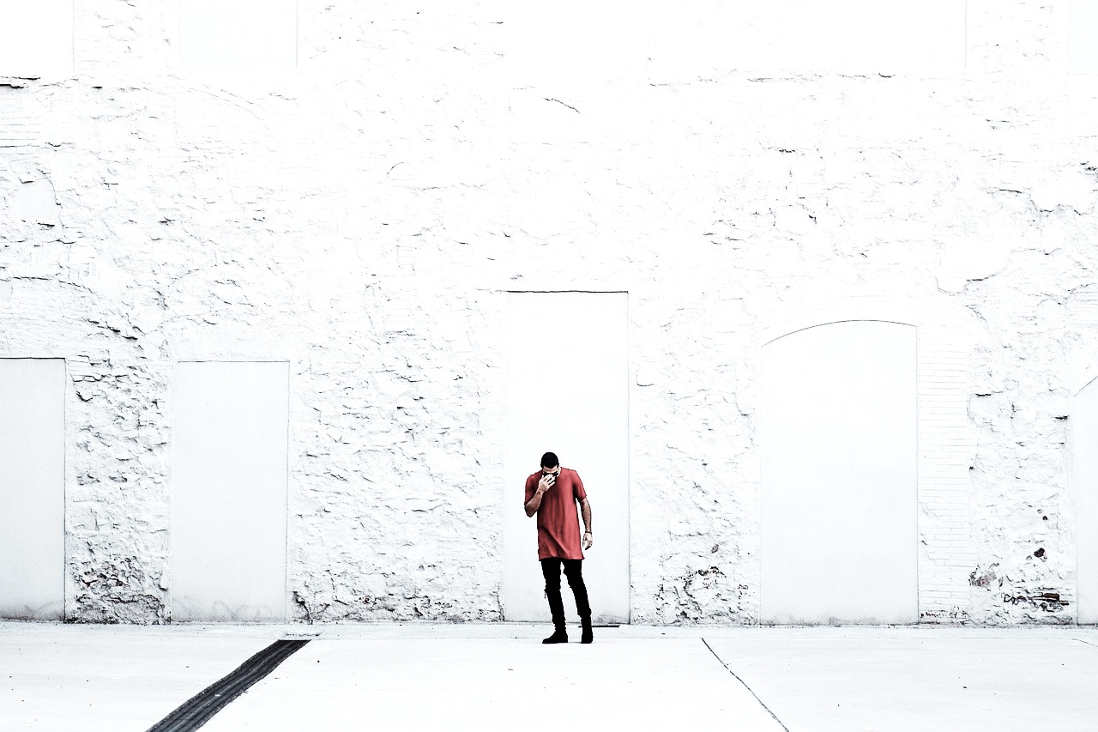
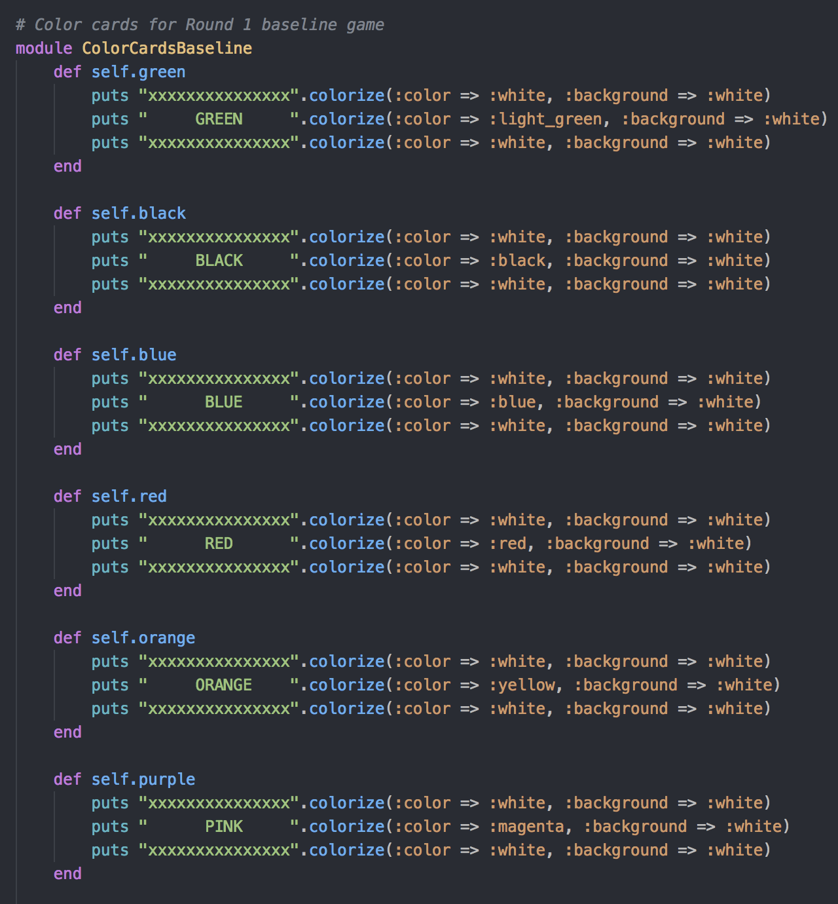
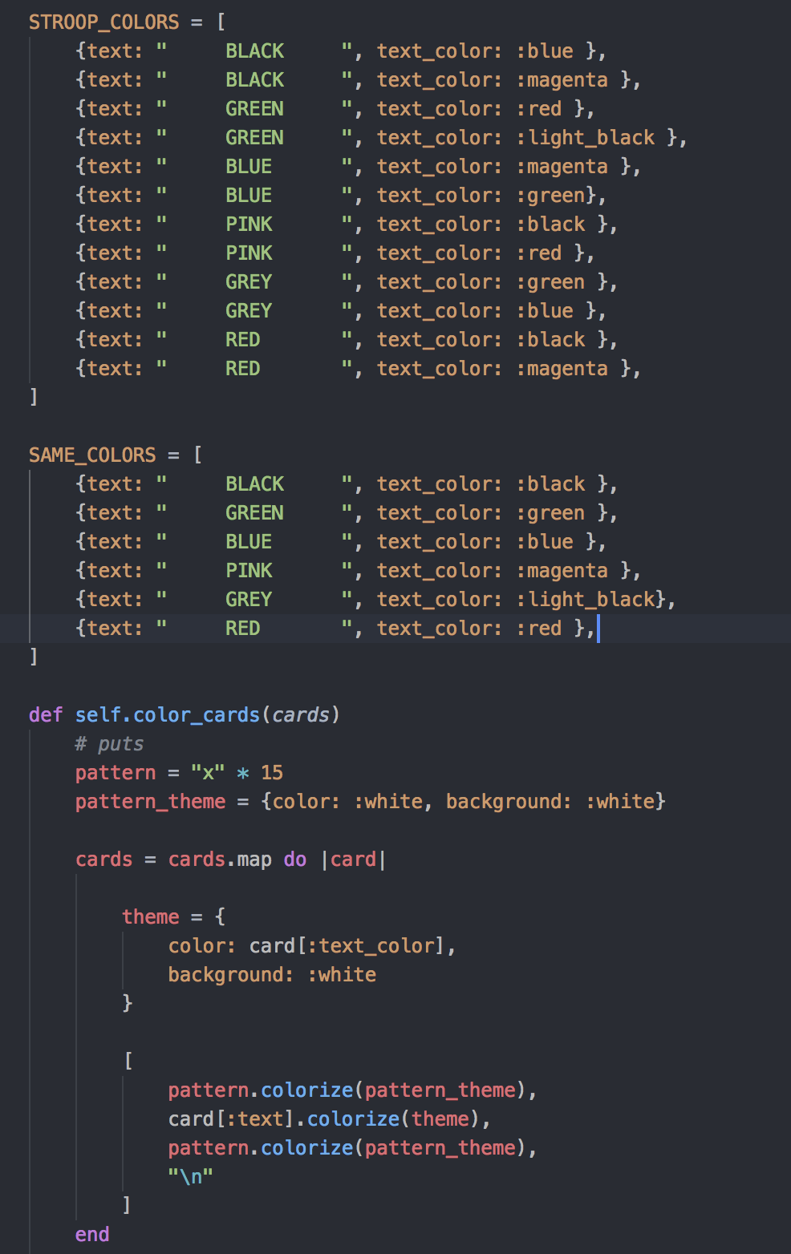
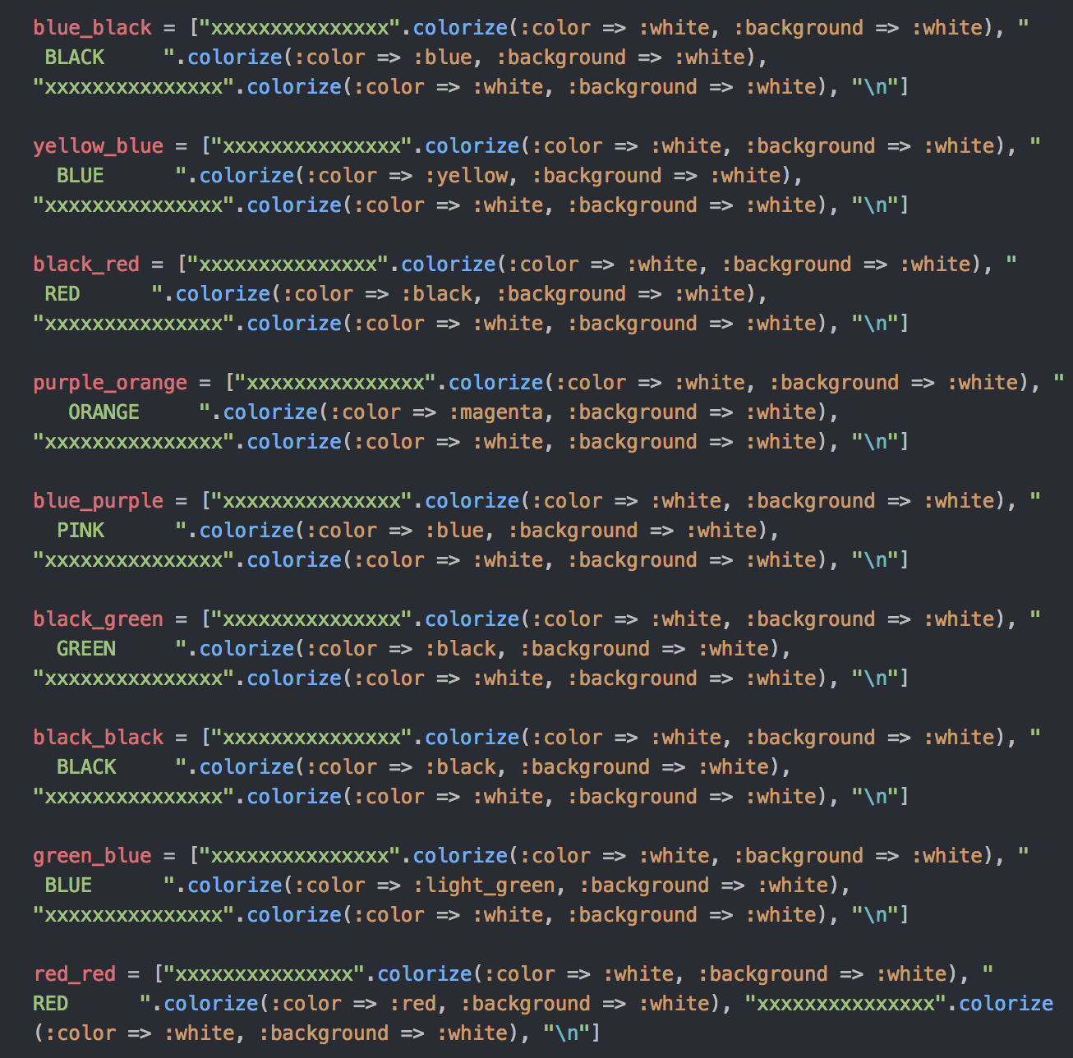
UX DESIGN & CHALLENGES
DRY code structures
Notes:
Aside from keeping the user’s experience clean with a easy to use layout, we also tried to keep the code dry and concise and spent some time polishing that

Slide 6
APPLICATION
DEMONSTRATION

